Slide 1


Savitribai Phule Pune University, Pune Amrutvahini College Of Engineering, Sangamner Department of E&TC Engineering A Presentation on
“Voice operated lift control system with safety”
Presented By
1.Bhoknal Gayatri Satish(Roll no.07) 2.Varpe Aditya Rajendra(Roll no.66) 3.Waman Onkar Uttam (Roll no.69) 4.Zanjare Shaileshumar Gangaram(Roll no.72)
Under the Guidance of
Prof. V. R. Aware

Slide 2
Contents
Introduction
Need of project
Research motivation
Aim and objective of project
Literature Survey
Problem Statement
Block Diagram of Project
Circuit Diagram
Prototype images
Description of Components
Hardware & Software requirements
Flow chart
Detailed algorithm
Advantages
Limitation
Application
Conclusion
References

Slide 3
Introduction
Physically challenged people face many problems every day. One of these challenges is the use of elevators in many buildings. They should be able to enjoy using the elevator easily.
To overcome this challenge for the them, we must focus on the following issues: Make sure the person is at the elevator door, get elevator there and ask person where to go and accordingly go to respective floor.
Speech is the superior personality of the human beings gifted by the nature. Speech helps to deliver the thoughts and messages between human. Speech recognition is the process of the computer recognizing human speech to generate a string of words or commands. Sometimes it is known as automatic speech recognition.
Speech recognition is becoming more perplexing and difficult task. The speech recognition research is focuses mainly on large vocabulary, continuous speech capabilities and speaker independence[3].
A voice-operated elevator system is proposed where the user’s input commands to control the movement of the elevator system are kept convenient for the users. The commands include voice input for the floor operations, directions, elevator car’s door operation, and a special command to call for emergency[4].

Slide 4
Need Of Project
The visually challenged people cannot use the elevator easily. It is difficult to use the keypad if they cannot see it. Sometimes the keypad has Braille technique, but they will have hard time for locating its place. Even though they found the keypad, how can they know the number if they do not know Braille?
They always need help in elevators from someone to press the button for them and to tell them when the elevator cabin arrives. In case of emergency how they will act if there is no one with them to help . So voice-controlled elevator can be a very good option for this people.
One more drawback of the current lift is that it cannot tell on which floor the lift is stuck, nor the parameters like temperature of motor, fire detection inside the lift. But by using this voice operated lift we can solve all these problems.

Slide 5
Research Motivation
Elevators are an integral part of modern urban infrastructure, providing vertical transportation for millions of people daily. While elevator technology has advanced significantly over the years, there are still areas that require improvement, particularly in terms of user convenience and safety.
As most of the physically challenged people find it difficult to operate the elevator. Also modern elevators lacks features such as voice recognition and also its connectivity with the internet for real-time parameters and controlling the elevator.
So we’ve found a solution on this, integrating voice recognition capabilities with the lift(elevator) for conveniently operate elevator with just some voice commands and also get feedback in audio format from the lift control system.
Also send all this info in real-time to the lcd screen.

Slide 6
Aim of the Project:
Design and development of a voice-controlled lift/elevator control system with enhanced security features for human-machine communication.
Objectives of the Project:
1. To operate lift through voice commands with easy use for people with visual and
physical challenges.
2. To measure parameters like floor number, weight of the lift, fire detection,
temperature of motor, etc.
3. To give real time information of lift parameters on the lcd screen.

Slide 7
Literature survey
SR.NO. | Title Of Research Paper | Author Name | Published Year | Proposed System
1 | Elevator Control Using Speech Recognition for People with Physical Disabilities[4] | Komal Mahajan, Riddhi Nahar, Dhanali Khairnar, Shrutika Kinge, Sujata Suryawanshi | 2021 | The research combines speech recognition technology with machine learning to make the elevator control equipment that can be controlled by voice. This system uses python based machine learning libraries with Raspberry pi 3B+. The word can be trained for more than hundreds of words.

Slide 8
SR.NO. | Title Of Research Paper | Author Name | Published Year | Proposed System
2. | Voice Operated Intelligent Lift[5] | Rashmi P C, Amulya, A Karthik Shetty, Akshata, Dilip Kumar U K | 2019 | In this system the lift operates based on the input voice commands. In this project MATLAB coding is used for voice recognition and IR sensor is used for detecting the floors and stopping the motor rotation. The DC motor is used for controlling the lift. The microcontroller is programmed using Embedded C.
3. | Voice Based Lift Control[6] | Malim Huzaifa Salim, Sami Jaitapkar, Faki Ziyaan, Kazi Ibrahim | 2022 | This system accepts input by microphone, and taking the elevator to the destination accordingly.

Slide 9
 |  |  |  | It uses raspberry pi and a speech API to communicate with cloud for the voice recognition.
4. | Implementation of Voice based Touchless Lift System[9] | B. Swathi, Akshay S Prathap, Aiswarya V Kumar, Ranjitha R, Raviteja Kaki | 2021 | This system uses Arduino Mega and Elechouse V3 Voice Recognition Module to correctly detect the command given by user, and uses servo motor to lift up and down the elevator, and a servo motor to open and close the doors of the elevator. For all this motors, it uses a relay driver circuit for driving the motors.

Slide 10
Problem Statement
“To design and develop a voice-controlled lift/elevator control system with enhanced security features for human-machine communication”

Slide 11
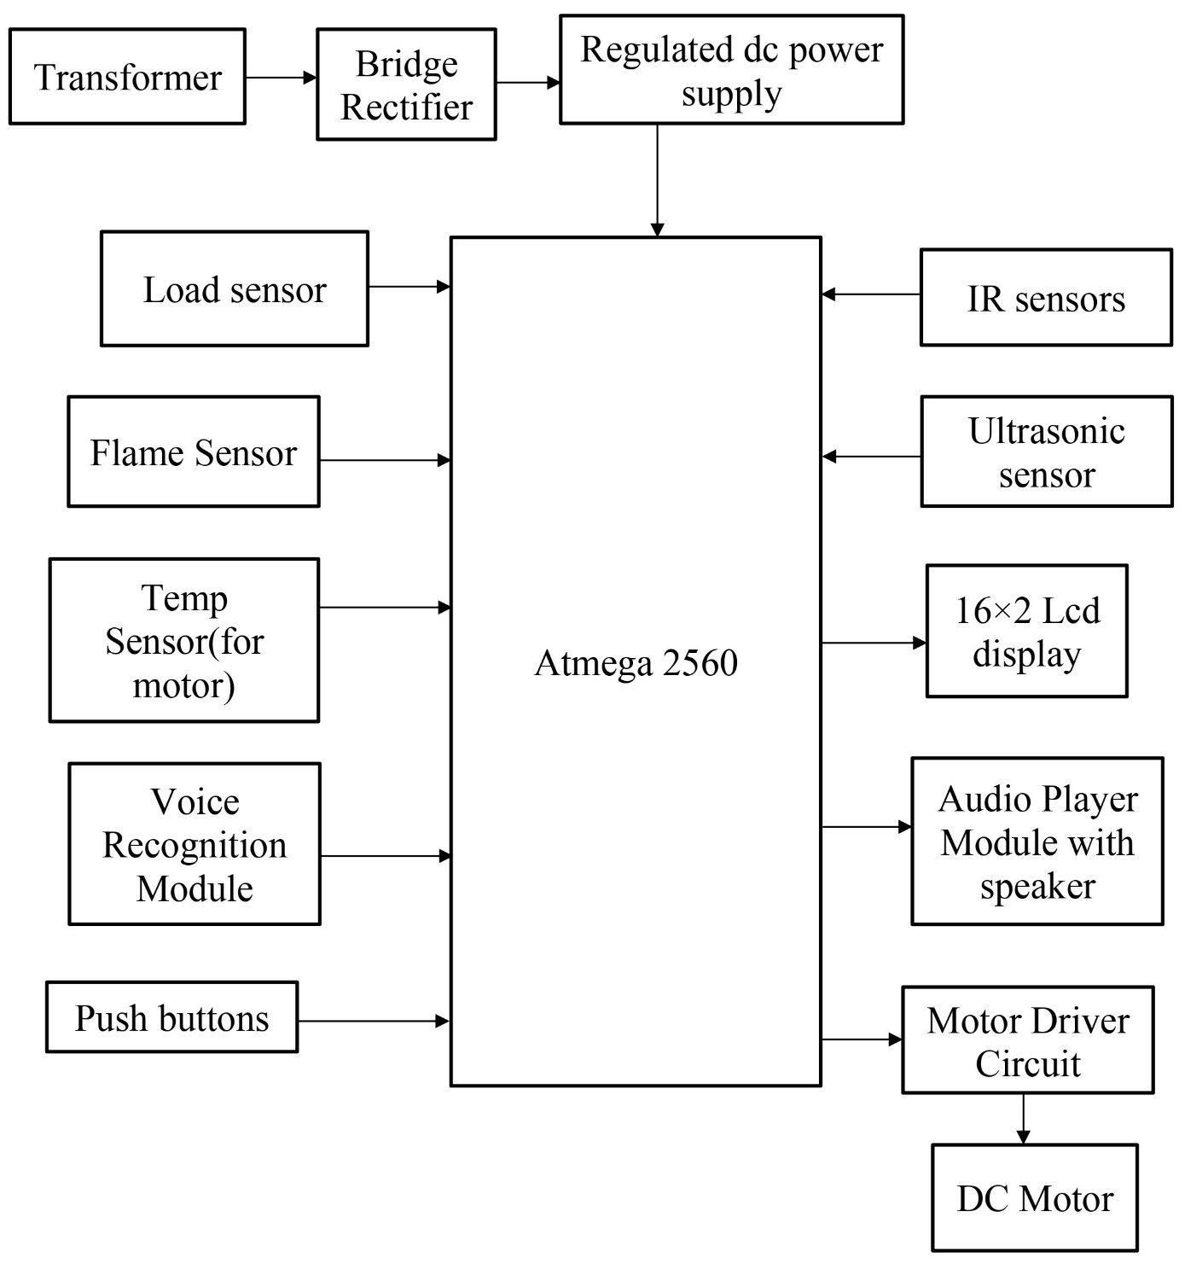
Block Diagram

Slide 12
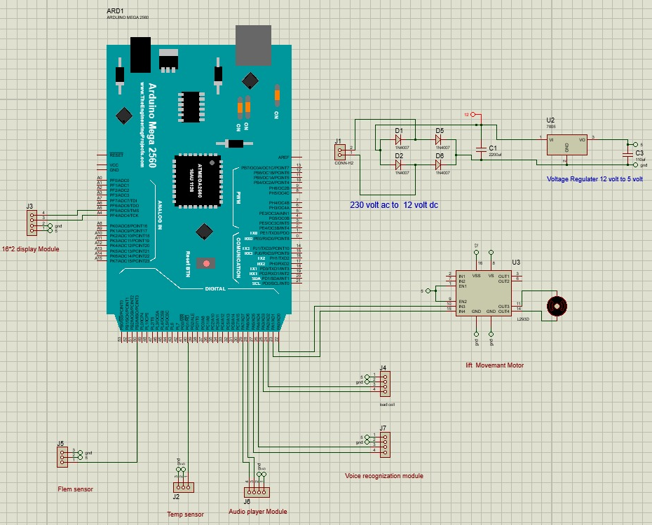
Circuit Diagram

Slide 13
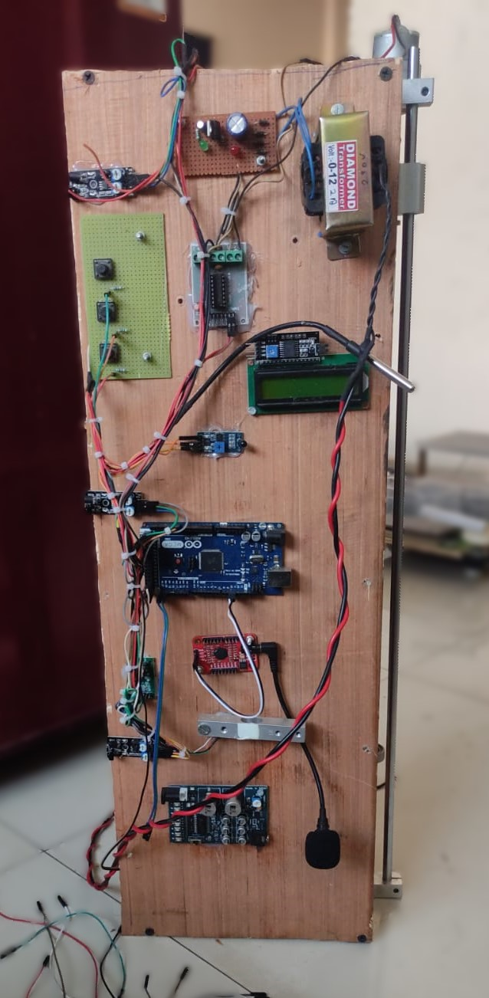
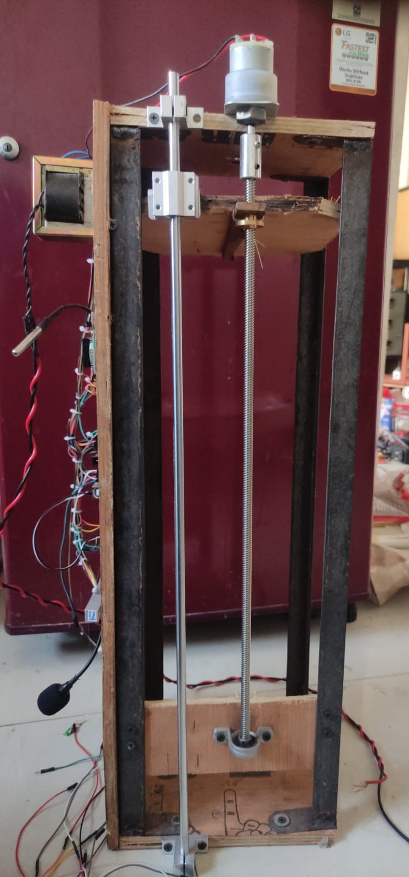
Prototype Images

Slide 14
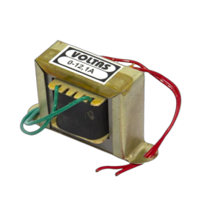
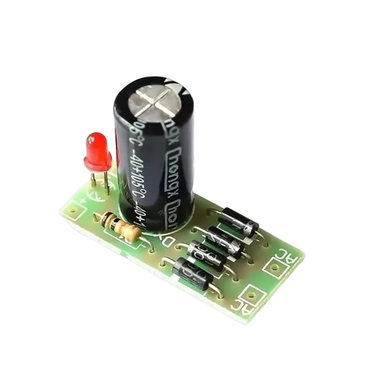
Description of Components
Transformer: Steps down the AC mains voltage to a suitable level for the rest of the system.
Bridge rectifier with dc regulated supply: Converts the AC voltage from the transformer to DC. And removes pulsating DC by using a electrolytic capacitor.

Slide 15
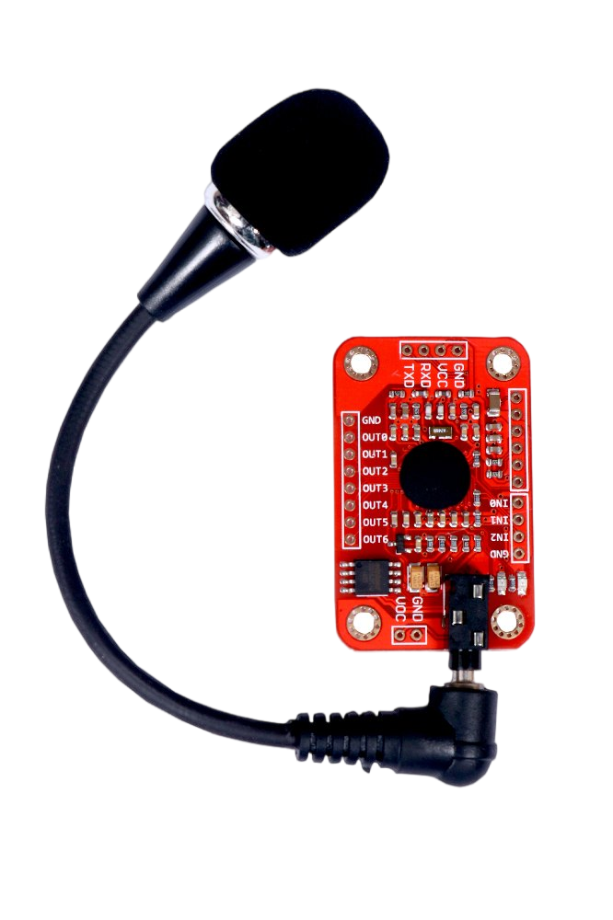
Voice recognition module(V3):
Converts the user's spoken commands into an command number which is already stored in module. Voice Recognition Module product is a speaker-dependent voice recognition module. It supports up to 80 voice commands in all.
Max 7 voice commands could work at the same time. Any sound could be trained as the command.
Users need to train the module first before let it recognizing any voice command.

Slide 16
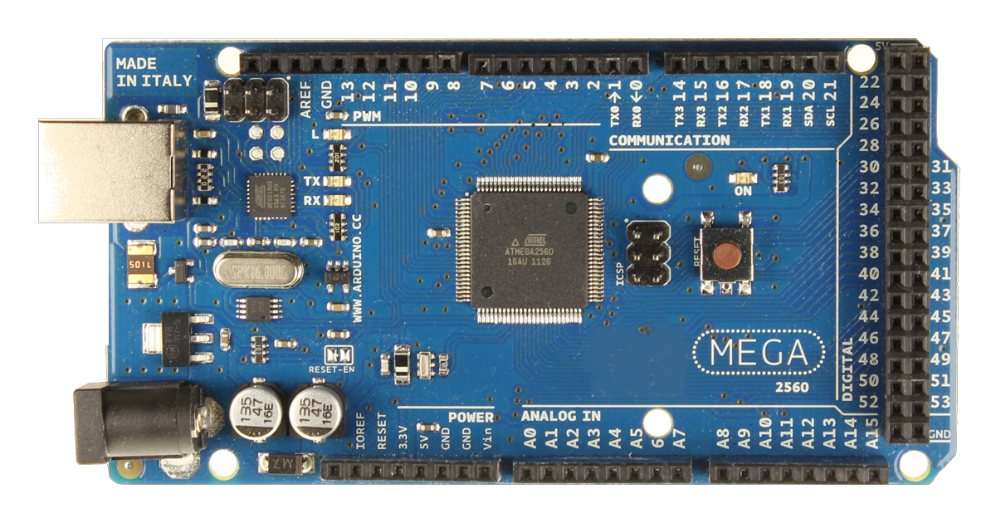
Atmega 2560 microcontroller[10]:
The brain of the system, which controls all of the other components. The ATmega2560 is an 8-bit, low-power microcontroller that is based on the AVR-RISC architecture. It's commonly found in the Arduino Mega 2560 development board.
The ATmega2560 has the following features:
54 digital input/output pins (of which 15 can
be used as PWM outputs)
16 analog input pins
4 hardware serial ports
16 MHz crystal oscillator
USB connection
Power jack
Reset button
256 KB of flash memory (of which 8 KB
is used for the bootloader)
8 KB of SRAM
4 KB of EEPROM

Slide 17
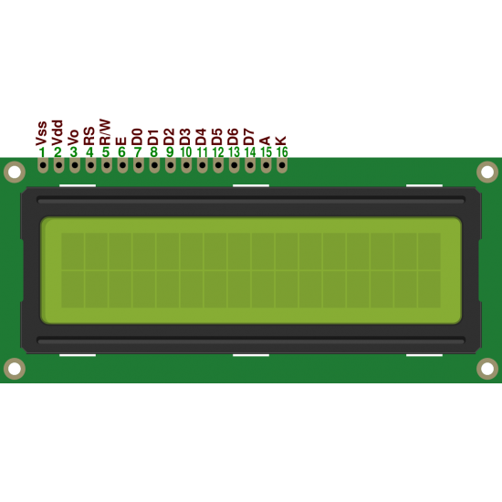
16x2 LCD display:
Displays the current floor number and other system information. A 16x2 LCD display can display 16 characters on 2 lines. The characters are white on a blue background. The display has a 5x7 pixel matrix for each character.
Here are some specifications for a 16x2 LCD display:
Display capacity: 16 characters x 2 rows
Display color: Blue backlit
Character size: 2.95 mm wide x 4.35 mm high
Current requirements: 2 mA @ 5 VDC
Voltage requirements: 5 VDC +/- 0.5V
Character pixels: 5 W x 7 H

Slide 18
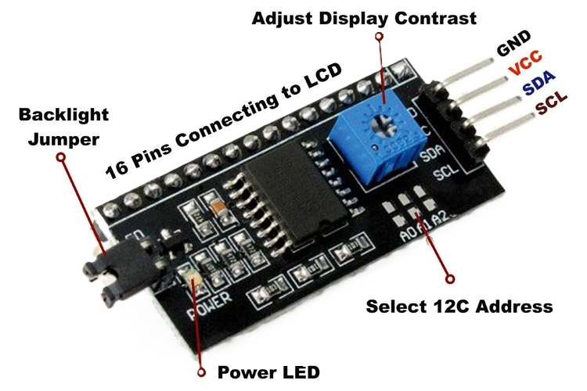
I2c module

Slide 19
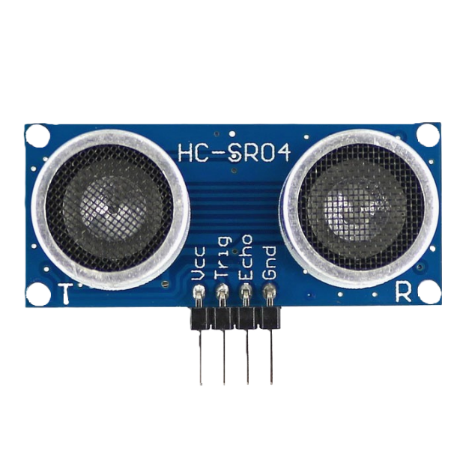
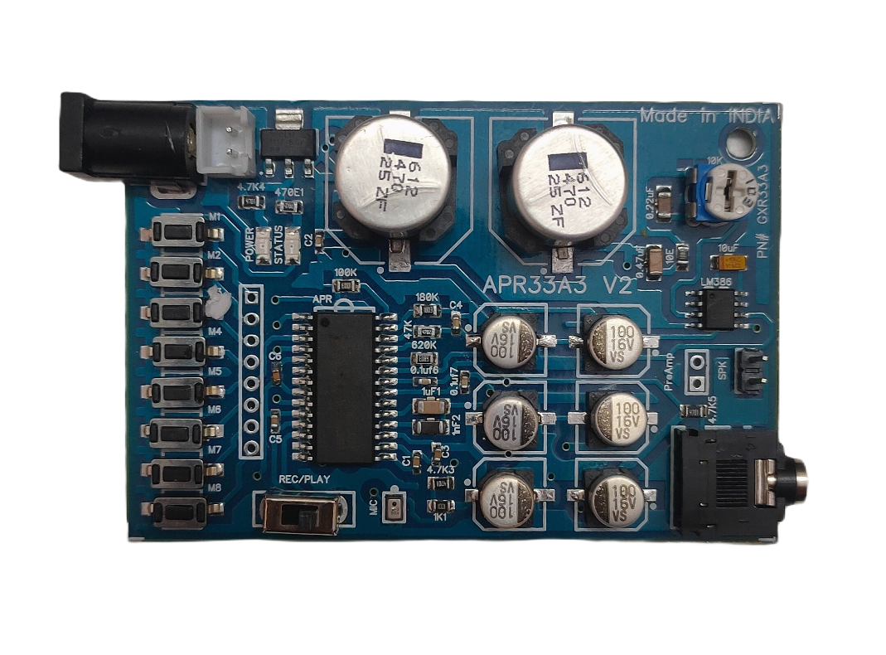
Ultrasonic Sensor(HC-SR04):
Audio player module(APR33A3): Plays audio cues, such as "Going up" and "Arrived at your floor.“
This Module is a reusable mass storage voice module,
that can plug a maximum capacity of 1GB SD card
memory and can load the WAV and AD4 audio.
Supports the FAT file system SD carrier.
Supports the playing of 4Bit ADCPM format files.
Recognize the voice files automatically.
Support microprocessors and key control.

Slide 20
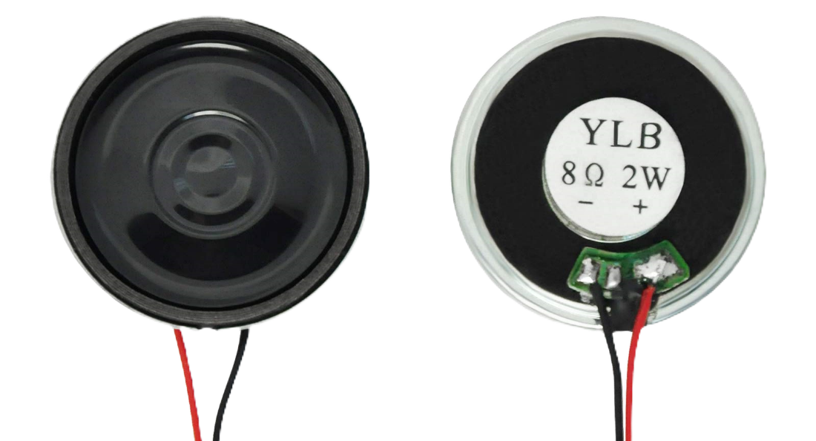
Speaker:

Slide 21
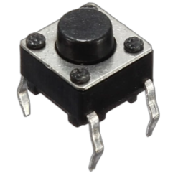
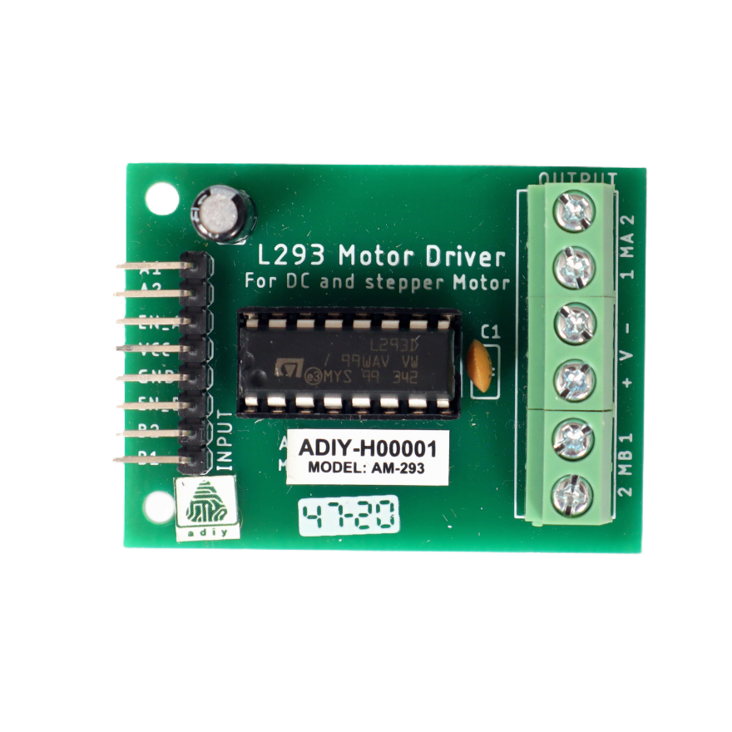
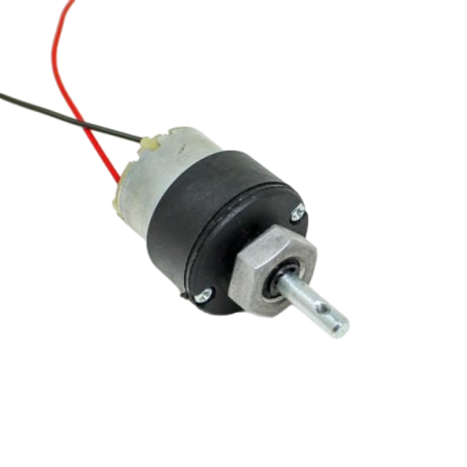
Push Buttons: They are used to manually use the elevator. This push buttons can be used as floor number burtons, lift arriving button, etc.
Motor Driver circuit(L293): Controls the DC motor. Also speed of motor can be controlled by providing appropriate signal at the “IN” pin. By using two relay circuit, we can revolve the DC motor in both directions as clockwise and anticlockwise
DC motor: Drives the lift car up and down the shaft.
This DC Motor 10RPM 12Volts can be used in all-terrain robots and a variety of robotic applications. These motors have a 3 mm threaded drill hole in the middle of the shaft thus making it simple to connect it to the wheels or any other mechanical assembly.

Slide 22
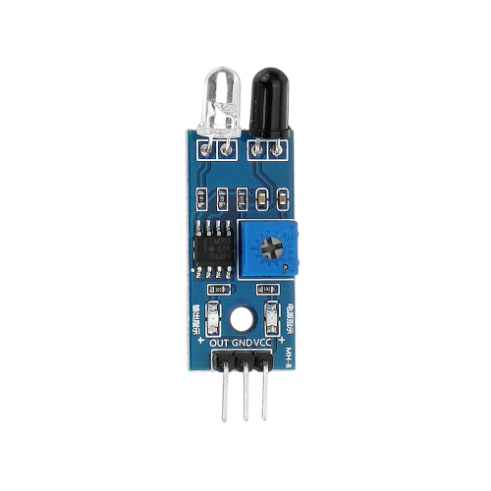
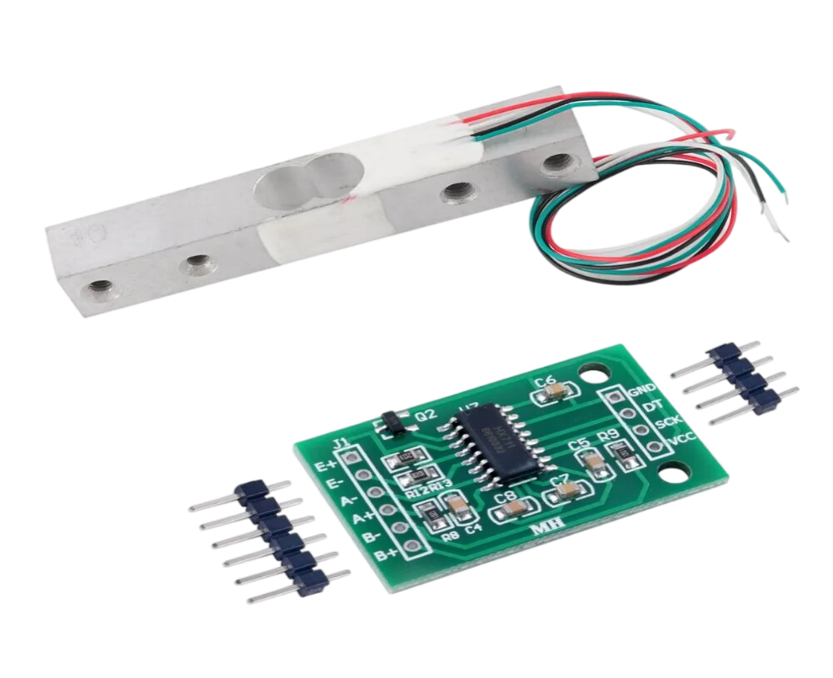
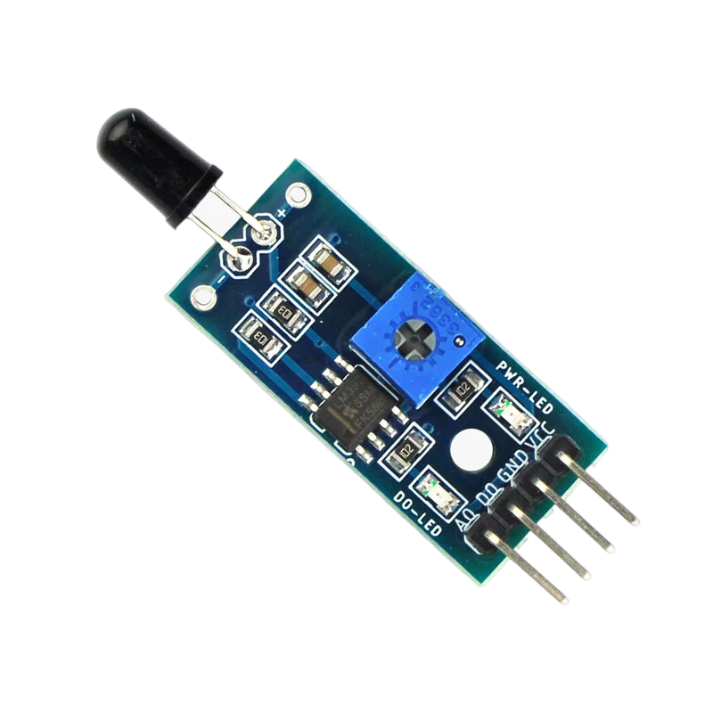
IR sensor(LM 393): Detects the floor number from which lift has passed.
Load sensor(with hx7111 sensor): Monitors the weight of the lift car and prevents it from being overloaded.
Flame sensor(YL 38): Detects fires in the lift.

Slide 23
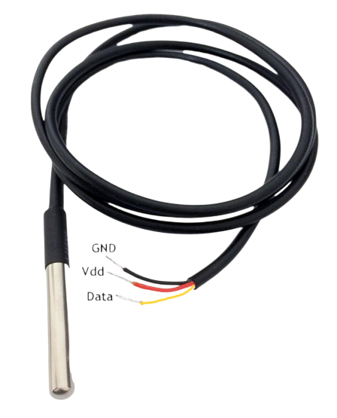
Temperature sensor (ds18b20): Monitors the temperature of the lift motor and prevents it from overheating.

Slide 24
Hardware and Software Requirements
H/W requirements:
Atmega 2560 microcontroller
Transformer
Bridge rectifier with dc supply
Load sensor (with hx7111 sensor)
Flame Sensor (YL 38)
Temp sensor (ds18b20)
Voice recognition module(V3)
Push buttons
IR sensors (LM 393)
Ultrasonic sensor (HC-SR04)
16×2 Lcd display
I2c module
Audio player module (APR33A3)
Speaker
Motor driver circuit (L293)
DC motor
S/W requirements:
Arduino IDE
PCB wizard

Slide 25
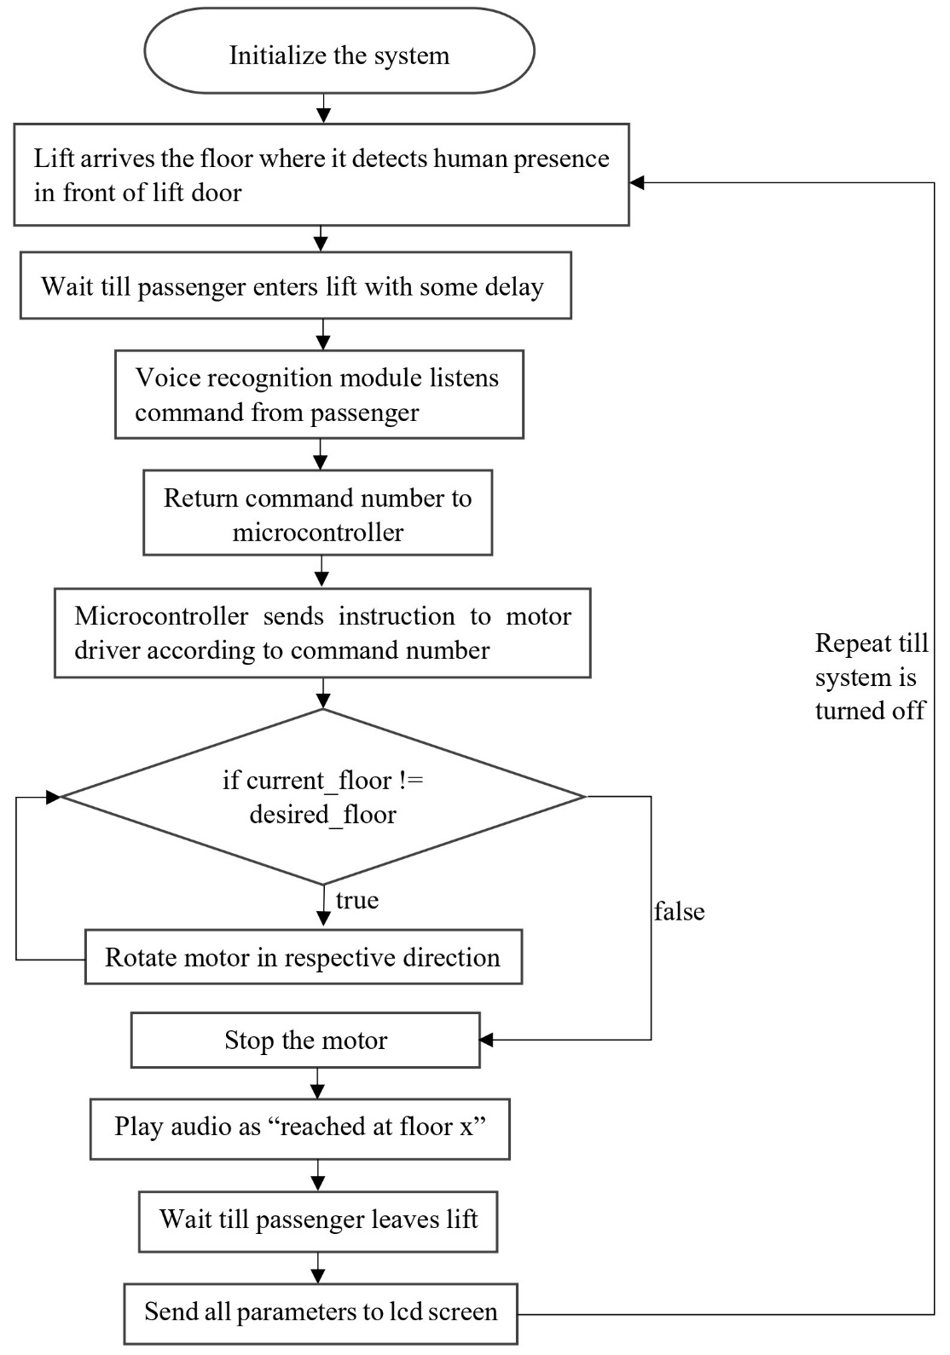
Flow chart

Slide 26
Detailed Algorithm
Initialize the system.
Lift arrives the floor where it detects human presence in front of lift door.
User enters into lift.
Listen for a voice command from the user.
Compare the voice command with already stored commands and return command number using the voice recognition module.
Microcontroller determines which floor the user wants to go to based on the command value returned by voice recognition module.
Send a signal to the relay driver circuit to activate the DC motor in the desired direction.
Monitor the current floor number using the Ultrasonic sensor.
When the lift car reaches the desired floor, send a signal to the relay driver circuit to deactivate the DC motor.
Play an audio cue to inform the user that they have arrived at their destination.
While all this is working, the floor number, motor temperature, flame sensor, and load sensor parameters are send to lcd screen for monitoring purpose.
Repeat steps 2-12 until the system is shut down.

Slide 27
Advantages
Accessibility: Voice control can be easier to use for people with physical disabilities or limitations than traditional button controls.
Hygiene: Using voice commands can help to reduce the spread of germs, as people don't need to touch buttons.
Convenience: Voice control can be a more convenient way to call a lift, especially when carrying items or with full hands.
Safety: The system includes safety features such as load sensors, IR sensors, flame sensors, temperature sensors, and ultrasonic sensors, which can help to prevent accidents.
Modernization: A voice-operated lift control system can give a building a more modern and high-tech feel.

Slide 28
Limitations
Accuracy: Voice recognition systems can sometimes be inaccurate, especially if there is background noise or if the speaker has a strong accent.
Privacy: Some people may be concerned about the privacy implications of using a voice-operated system.
Cost: Installing and maintaining a voice-operated lift control system can be more expensive than a traditional system.

Slide 29
Application
Hospitals: In hospitals, voice control can be helpful for patients and staff who may have difficulty using traditional buttons.
Hotels: Voice-operated lifts can be a luxurious and modern addition to hotels.
Residential buildings: Voice control can be a convenient option for people living in residential buildings, especially for those with disabilities.
Public buildings: Voice-operated lifts can be helpful in public buildings such as libraries and museums, where people may be carrying items or have difficulty using traditional buttons.

Slide 30
Conclusion
Voice-controlled elevators are a long-term solution that can be used by anyone, including people with disabilities. They have the potential to make life easier for everyone and reduce the spread of germs.
In addition to the benefits mentioned above, voice-controlled elevators could also be used to improve security and convenience. For example, authentication could be used to restrict access to certain floors, and sensors could be used to reduce the need for users to give specific commands.
Voice-controlled elevators have a wide range of potential applications, including in homes, offices, hospitals, hostels, and public places.
Overall, voice-controlled elevators are a promising technology with the potential to improve our lives in many ways.

Slide 31
References
Dilip Mathuria, Aditya Gaur, Ashish Gupta, “FPGA Implementation of Biometric based Elevator Controller”, IJETSR Volume 5, Issue 3, March 2018
Farouk Salah Mohamed Saod, Dr Maher Abdel Aziz, “Elevator for blind people using voice recognition” International Journal of Scientific & Engineering Research vol 9 Issue 7,July 18
Kaladharan N, Assistant Professor ,Dept. of Electrical Engineering. Annamalai University, IJIRCCE, “A study of speech recognition” volume.3,issue 9,page 8030- 8034,September 2015.
Komal Mahajan, Riddhi Nahar, Dhanali Khairnar, Shrutika Kinge, Sujata Suryawanshi, “Elevator Control Using Speech Recognition for People with Physical Disabilities” IJARIIE Vol-7 Issue-3 2021
Rashmi P C, Amulya, A Karthik Shetty, “Voice Operated Intelligent Lift” JETIR February 2019, Volume 6, Issue 2
Malim Huzaifa Salim, Sami Jaitapkar, Faki Ziyaan, Kazi Ibrahim, “Voice Based Lift Control” IJRASET Volume 10 Issue V May 2022

Slide 32
P.Cernys, V.Kubilius, V.Macerauskas, K.Ratkevicius, “Intelligent Control of the Lift Model” IEEE international Workshop on Intelligent Data Acquisition and Advanced Computing System: Technology and Applications 8-10 September 2003
Aishwarya Pokharkar, Niriksha Poojari, Harish Pawar , Amey Patil, “Voice Operated Elevator” IJISRT Volume 6, Issue 5, May – 2021
B. Swathi, Akshay S Prathap, Aiswarya V Kumar, Ranjitha R, Raviteja Kaki, “Implementation of Voice based Touchless Lift System” IJSRCSEIT Volume 7, Issue 4, July-August-2021
Datasheet of Atmega 2560 microcontroller [https://ww1.microchip.com/downloads/en/devicedoc/atmel-2549-8-bit-avr-microcontroller-atmega640-1280-1281-2560-2561_datasheet.pdf]

Slide 33
Thank You !!!

